Slide 1
Digital Preservation at the Center for Jewish History February 23, 2011
Andrea Buchner
Director, Gruss Lipper Digital Laboratory
abuchner@cjh.org

Slide 2
What Is Digital Preservation?
Two foundational documents:
The OASIS Reference Model, 2001 Consultative Committee for Space Data Systems
http://public.ccsds.org/publications/archive/650x0b1.pdf
“…permanent, or indefinite long-term, preservation of digital information…”
Trusted Digital Repositories: Attributes and Responsibilities, 2002
RLG/OCLC
http://www.oclc.org/research/activities/past/rlg/trustedrep/repositories.pdf
“…reliable, long-term access to managed digital resources for its designated community, now and in the future…”
Digital preservation can be defined as managed activities that are necessary for the long-term maintenance of a digital asset and its continued accessibility through time and technology

Slide 3
Trusted Digital Repository Attributes
Administrative responsibility
Organizational viability
Financial sustainability
Technological suitability
System security
Procedural accountability

Slide 4
Five Organizational Stages
Stage 1 (Acknowledge) involves coming to understand that digital preservation is a local problem
Stage 2 (Act) involves initiating digital preservation projects
Stage 3 (Consolidate), the organization moves from projects to programs
Stage 4 (Institutionalize) involves incorporating the larger environment and rationalizing programs
Stage 5 (Externalize) involves embracing inter-institutional collaboration and dependencies

Slide 5
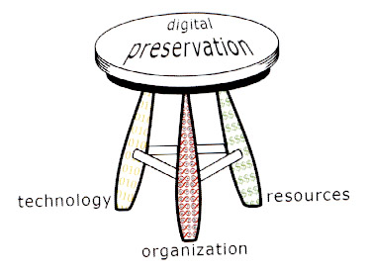
The Three Legged Stool

Slide 6
Organizational Infrastructure
Mission and Goals: www.digilab.cfjh.net/charter/mission-goals.html

Slide 7
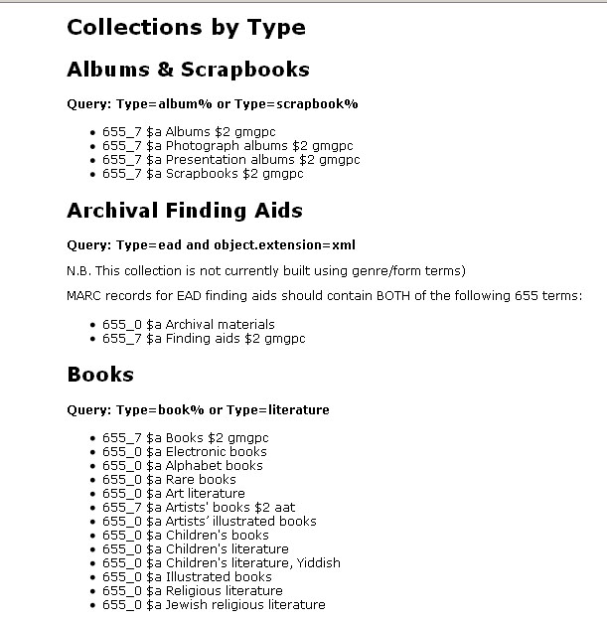
Organizational Infrastructure
Standards and Guidelines: http://digilab.cfjh.net/metadata/manual/genre-form.html

Slide 8
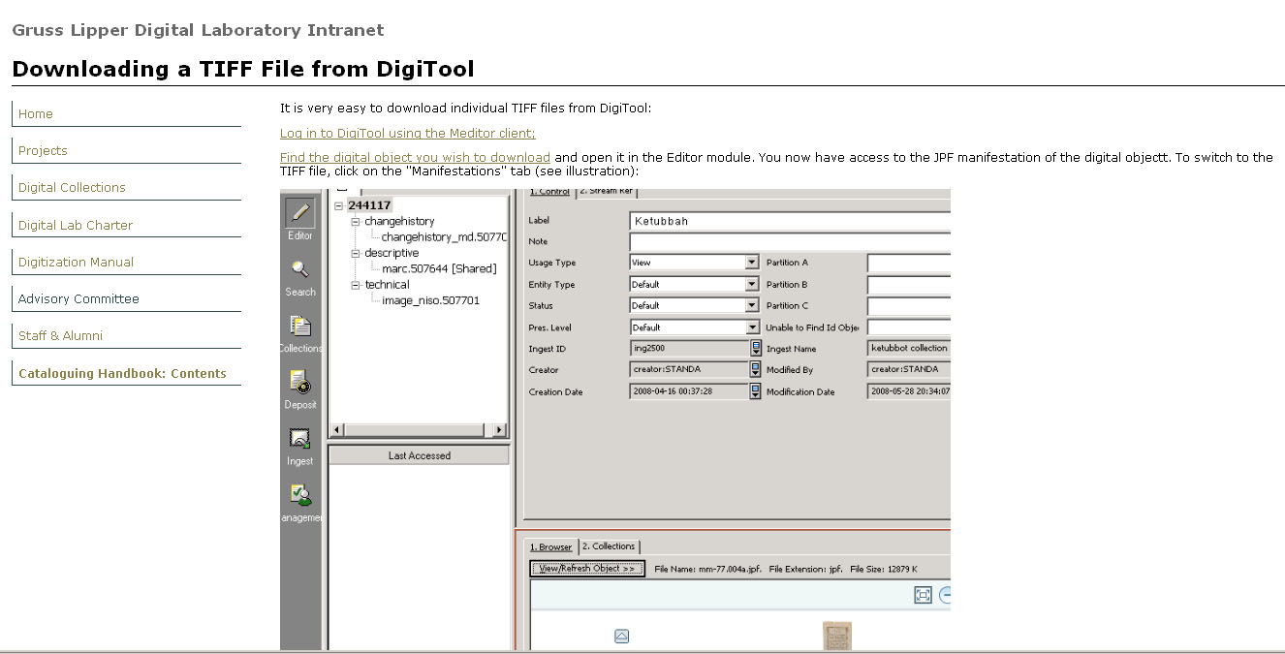
Organizational Infrastructure
Instructions: http://digilab.cfjh.net/metadata/manual/download.html

Slide 9
Organizational Infrastructure
Digital Imaging Specifications: http://digilab.cfjh.net/manual/imaging-specs.html

Slide 10
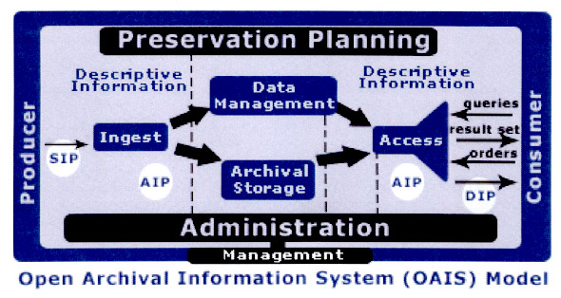
Technological Infrastructure
OASIS-compliant system

Slide 11
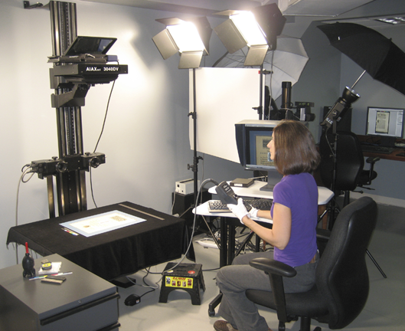
Resources

Slide 12
Result of Analysis
CJH is in the third stage
Strengths: OASIS-compliant, policies, standards, limited sustainable funding
Weaknesses: digital preservation is not implemented across all institutions
Recommendation: more collaboration, more extensive policies

Slide 13
Questions?
Andrea Buchner
Director, Gruss Lipper Digital Laboratory
abuchner@cjh.org

